Slide 1
THE USE OF EXPLICIT HEALTH BENEFITS PACKAGES INCREASES SUPPORT FOR UNIVERSAL HEALTH CARE FOR PEOPLE WITH HIGH OBJECTIVE NUMERACY
A Masters Thesis
presented to the Faculty of the Graduate School
at the University of Missouri - Columbia
By: Sean Duan

Slide 2
Why this project?
Health Care in the U.S. is broken
UHC works for other countries
Drug costs out of control
Medical costs most common cause of bankruptcy (Galvani et al 2017)
Spend less, better outcomes
Drug price negotiation
Increase in population insured

Slide 3
Why this project?
What Causes Opposition to UHC?
Too complicated!
Hard to define!
Measure Comprehensibility
It’s unfair!
Measure Perceived Equity

Slide 4
What Solves These Issues?
Health Benefit Packages (HBP) solves these! ¹
Explicit entitlements
200$ for Dental Work, Pay 50$ a day for Hospitalization
Public facing rules
Budget limits
Transparent requirements
¹ Glassman, Amanda, Ursula Giedion, Yuna Sakuma, and Peter C. Smith. 2016. “Defining a health benefits
package: What are the necessary processes?” Health Systems and Reform 2 (1): 39–50. https://doi.org/
10.1080/23288604.2016.1124171.

Slide 5
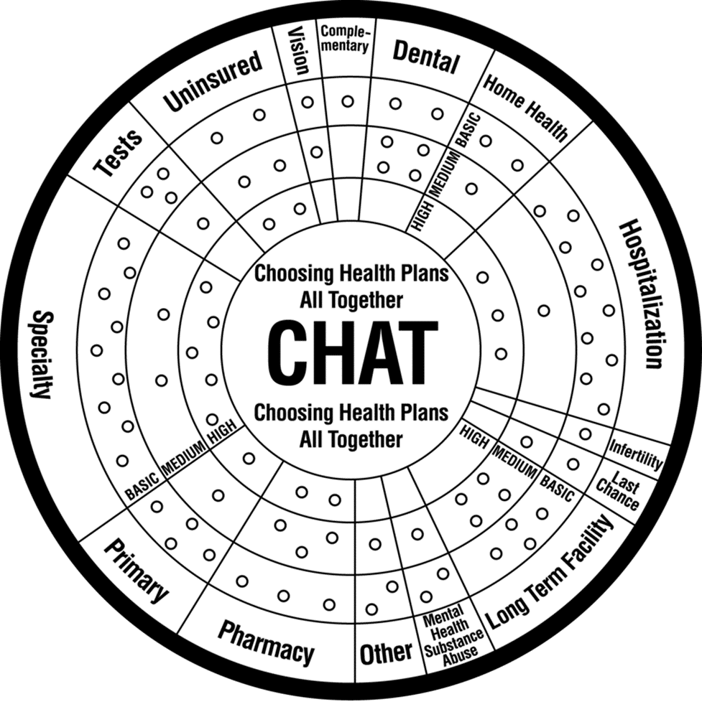
CHAT (Choosing Healthplans All Together) Exercise¹
‘Gamifies’ creating HBPs
Rationing of limited resources
Many different healthcare options
Levels of intensity
CHAT is easy
97% found easy to do
86% satisfied with their plan
¹ Danis, Marion, Andrea K. Biddle, and Susan Dorr Goold. 2002. “Insurance benefit preferences of the low income
uninsured.” Journal of General Internal Medicine 17 (2): 125–33. https://doi.org/10.1046/j.1525-
1497.2002.10609.x.
² Hurst, Samia A., Mélinée Schindler, Susan D. Goold, and Marion Danis. 2018. “Swiss-CHAT: Citizens discuss
priorities for Swiss health insurance coverage.” International Journal of Health Policy and Management 7 (8): 746–54. https://doi.org/10.15171/ijhpm.2018.15.

Slide 6
Hypothesis
HBP ↑ Perceived Equality / Comprehensibility
Mediational relationship
Perceived Equality ↑ UHC Support
Perceived Comprehensibility ↑ UHC Support
Moderating Factors – No a priori hypothesis

Slide 7
Study 1

Slide 8
Method: Design
2x3 mixed subjects design
Multi level model
Measurement Time > Subject
Independent variable
Time of measurement (pre/post intervention)
Experimental condition (control/active/passive)

Slide 9
Method: Materials
Choosing Healthplans All Together (CHAT) Exercise ¹
“Blank” version – Active
“Filled” version – Passive
“Pizza” version - Control
¹ Danis, Marion, Andrea K. Biddle, and Susan Dorr Goold. 2002. “Insurance benefit preferences of the low income
uninsured.” Journal of General Internal Medicine 17 (2): 125–33. https://doi.org/10.1046/j.1525-
1497.2002.10609.x.

Slide 14
Results: Quantitative
Intervention:
↑ UHC Support!
Active = Passive
Time Spent:
No effect on UHC support

Slide 15
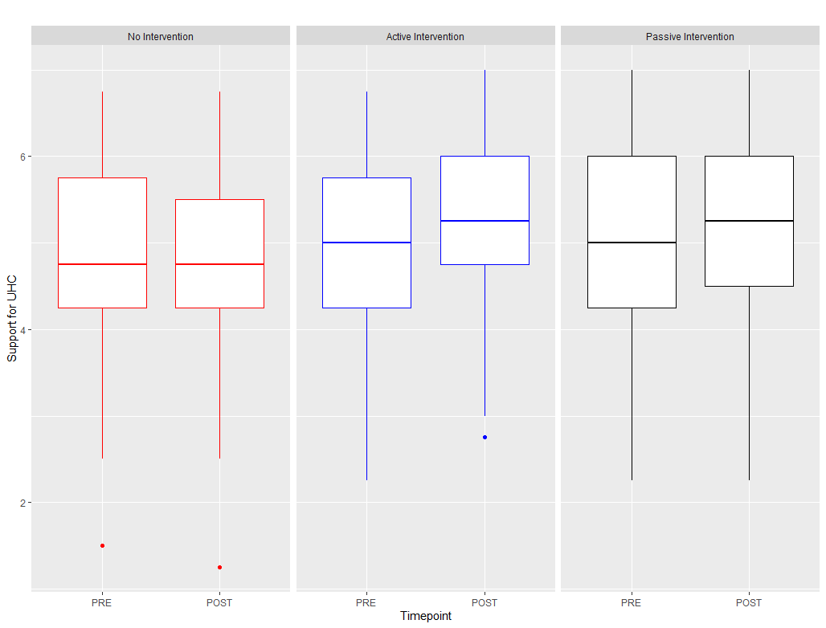

Slide 16
Results: Qualitative
“ What are your thoughts about the exercise you just completed?”
Confusion? – 10%
“It was a little confusing if you aren't very familiar with insurance and health care.”
Interesting! – 32%
“It was hard to choose because some of the parts in the insurance plan would've been nice to have but no necessary for me personally.”

Slide 17
Study 2

Slide 18
Method: Design
2x2 mixed subjects design
Multi level model
Measurement Time > Subject
Independent variable
Time of measurement (pre/post intervention)
Experimental condition (control/HBP exercise)

Slide 19
Method: Materials
Choosing Healthplans All Together (CHAT) exercise
Web-exercise version
‘Traditional’ UHC information
Pamphlets from WHO ¹ and World Bank ²
¹ https://www.who.int/health-topics/universal-health-coverage#tab=tab_1
² www.worldbank.org/health

Slide 20
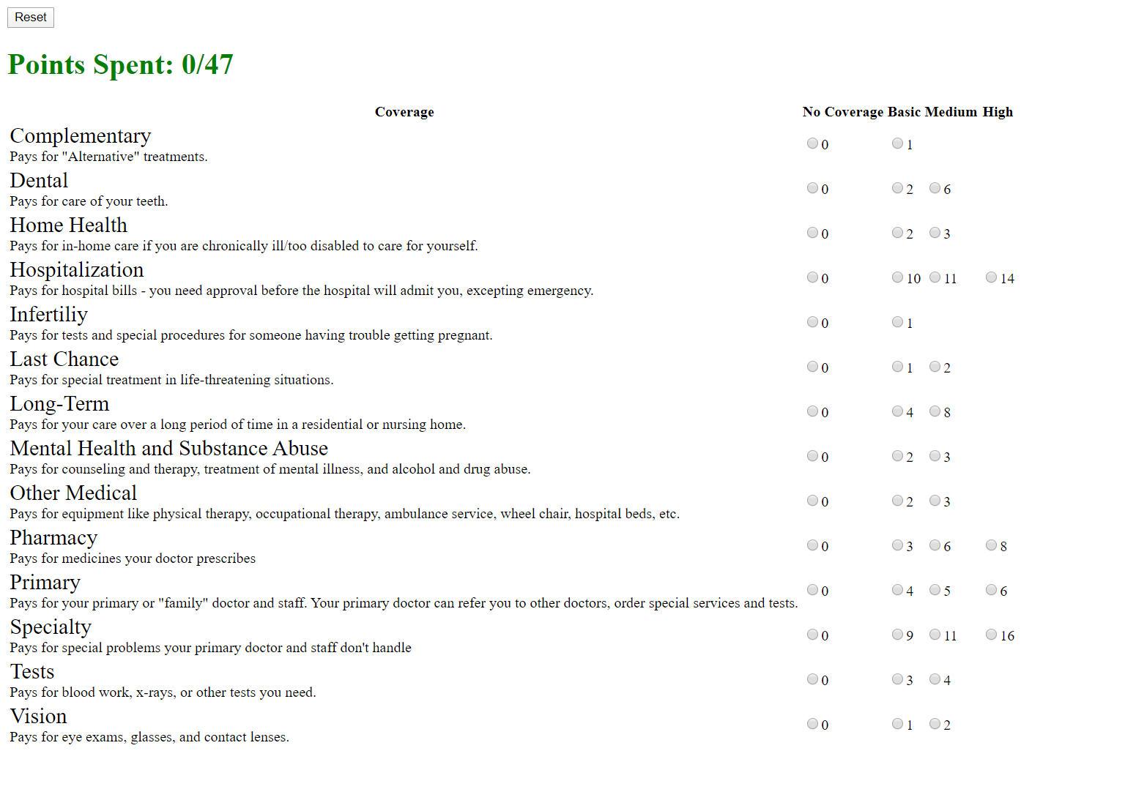

Slide 21
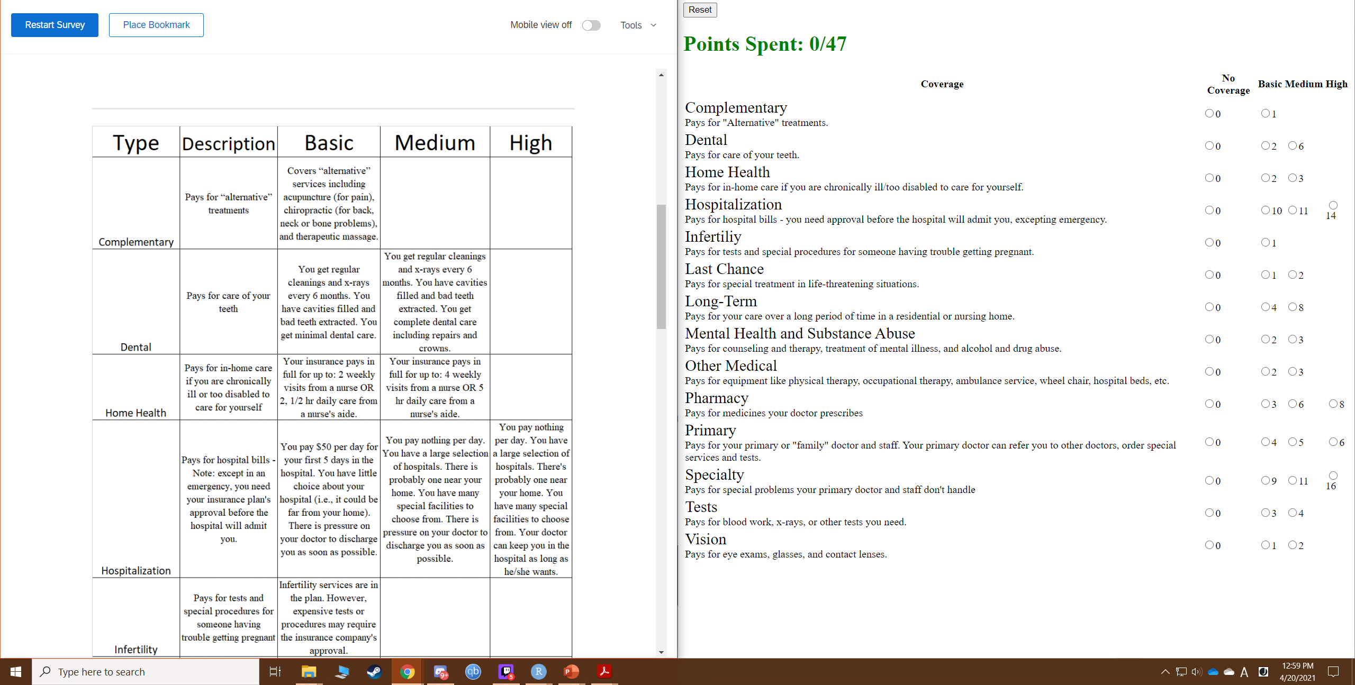

Slide 22


Slide 23
Results

Slide 24
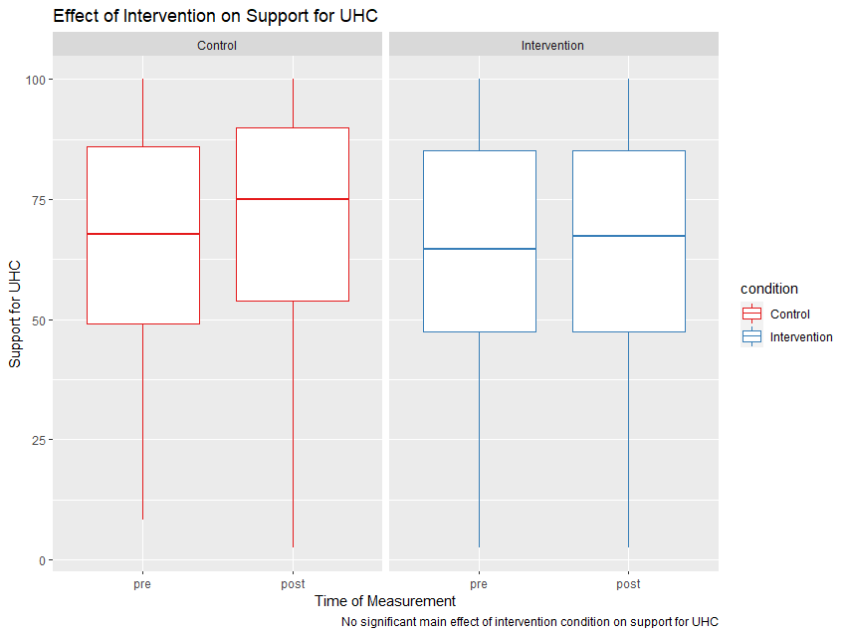

Slide 25
Mediational Effects

Slide 26
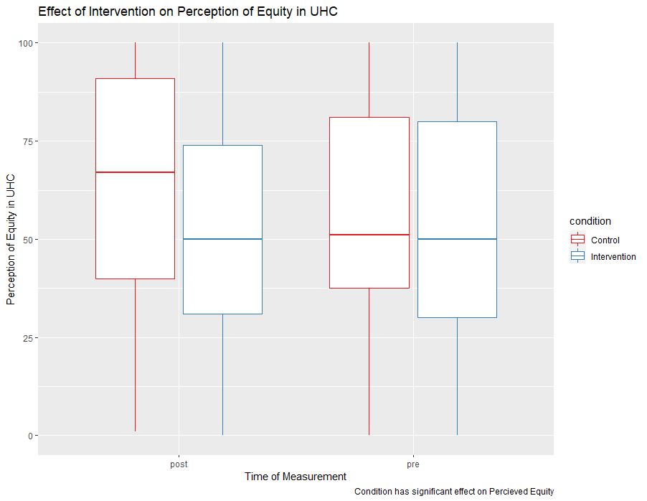

Slide 27
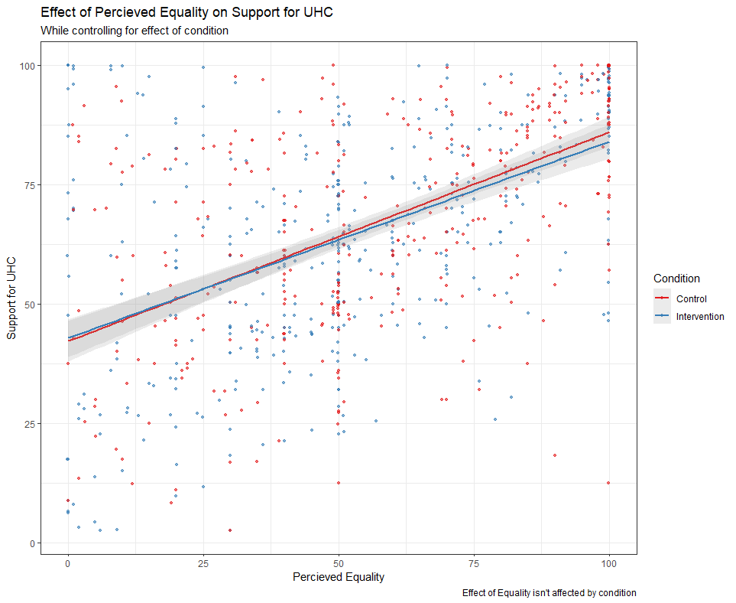

Slide 28
Perceived Equality
-4.53 **
0.42 ***
Condition
Support for UHC
-3.547 * (.04)

Slide 29
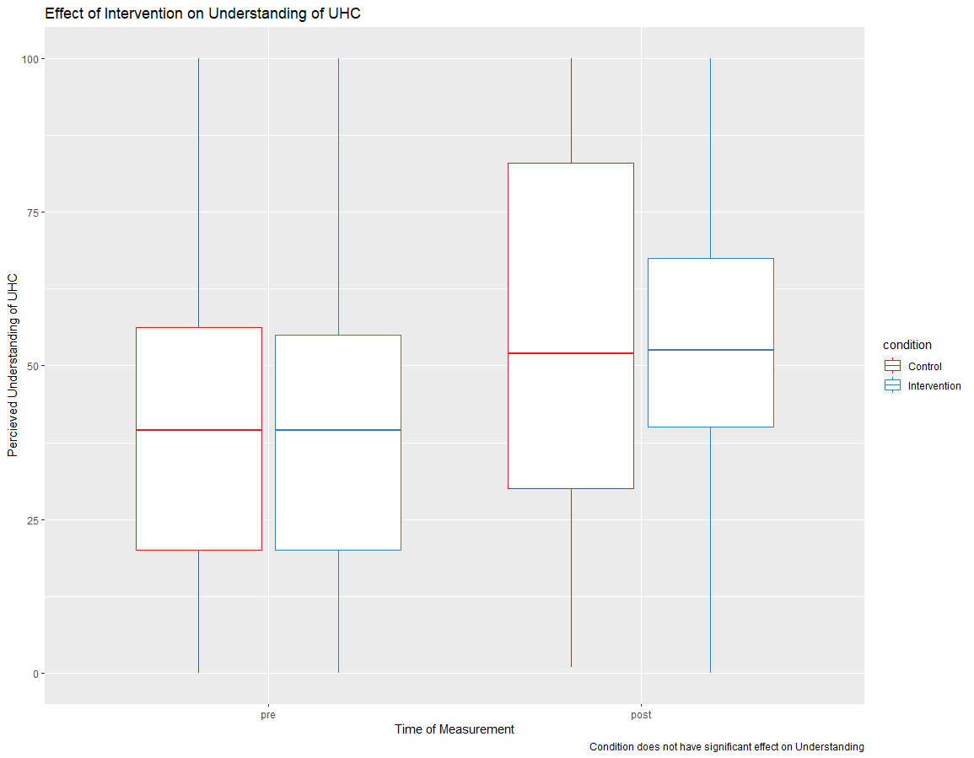

Slide 30
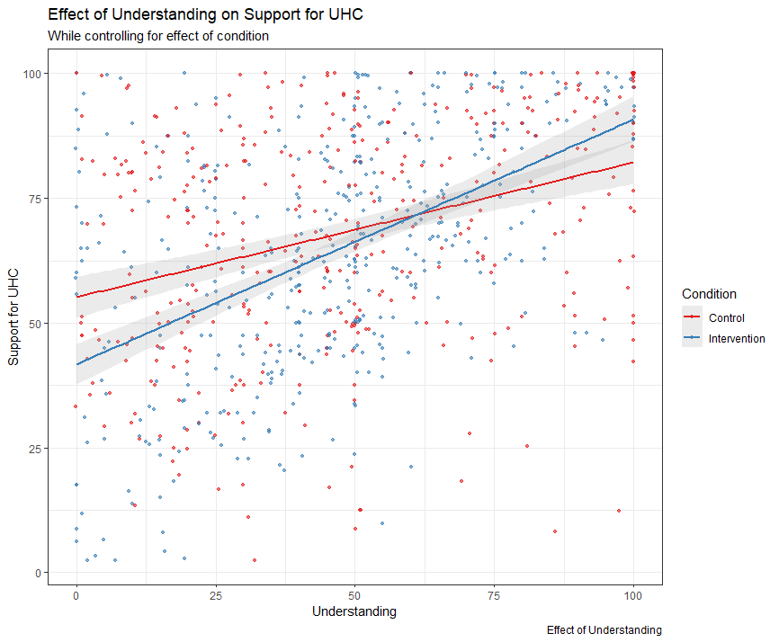

Slide 31
Moderating Effects

Slide 32
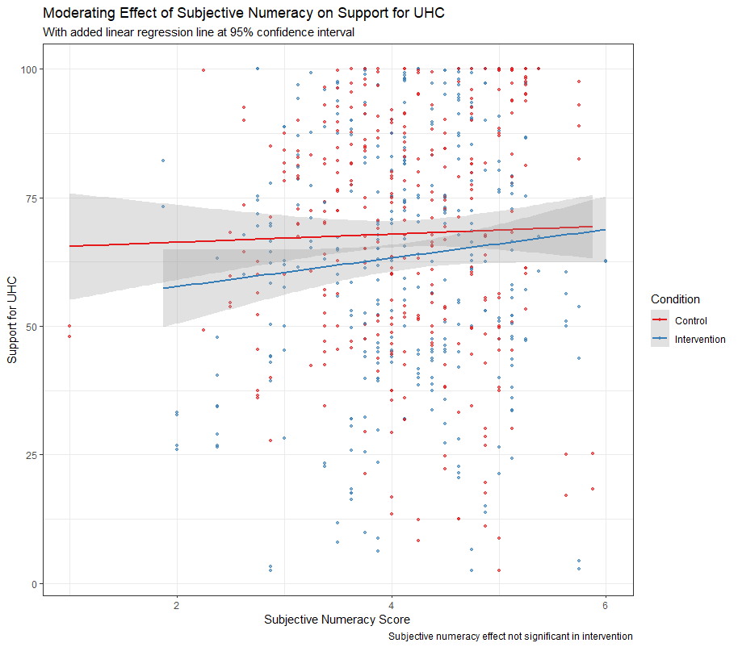

Slide 33
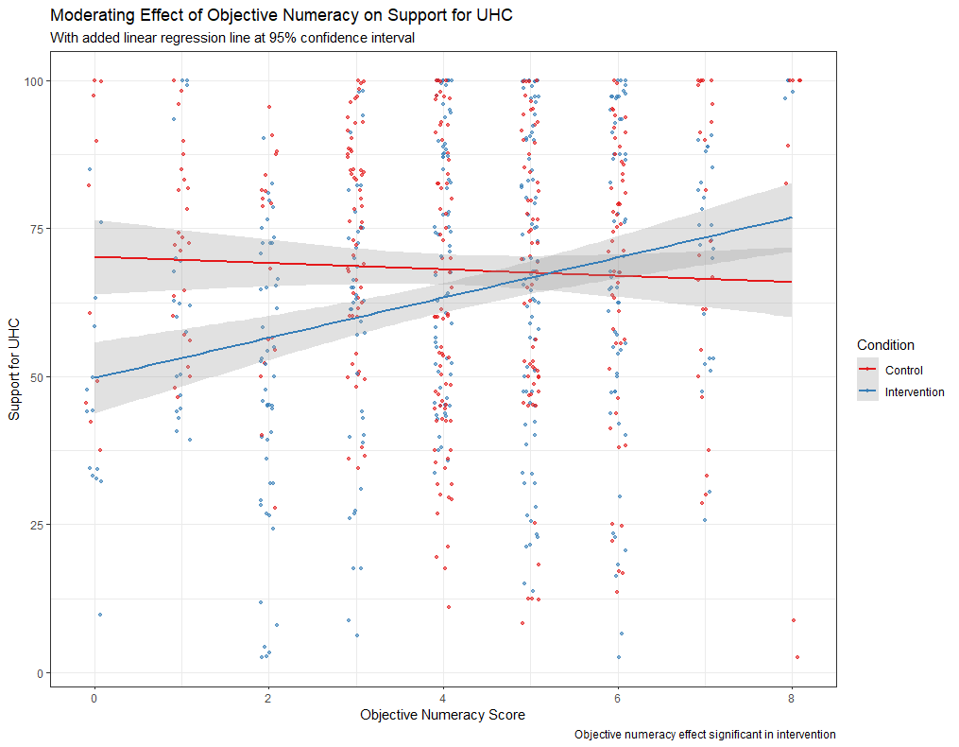

Slide 34
Results: Quantitative
Intervention did not ↑ Support UHC
Mediational Relationship exists!
Intervention did not ↑ Perceived Equality
Perceived Equality ↑ Support UHC
Control did ↑ Perceived Equality
No difference in ↑ Understanding b/w conditions
Understanding ↑ Support UHC
Moderating Relationship Exists!
Subj Numeracy does not ↑ Support UHC
Obj Numeracy ↑ Support UHC
Intervention only!

Slide 35
Results: Qualitative
Difficult
“it was much more difficult than I thought it was going to be; I had to compromise points in some places to be able to get at least basic coverage in other areas”
Interesting
“Interesting that my answers changed. I would be interested in seeing someone against Universal Health Care make a study, too.”
Enjoyable/Fun/Worked
“Enjoyed it, overall I believe that there should be Universal Health Care, but I did not realize how complicated it was. This exercise showed me how complicated it will be if the US decides to go through with something like this.”

Slide 36
Results: Qualitative
Intervention
Difficult – 23%
Interesting – 49.8%
Enjoyable/Fun/Worked – 18.4%
Control
Difficult – 0%
Interesting – 53%
Enjoyable/Fun/Worked – 8.7%

Slide 37
Extensions?
Using LIWC for more structured qualitative analysis
More ‘neutral’ control material?
Measure political orientation?
Compare against private healthcare info?
Determine how/why objective numeracy ↑ UHC supp in intervention only?
Measure trading off equity/efficiency
Alternative ways to measure equity

Slide 38
Conclusion
Mediational relationship of Perceived Equity seems to exist!
Perceived Equity ↑ UHC Support
Control ↑ Perceived Equity
Intervention does not ↑ Perceived Equity
Mediational relationship of Comprehensibility does not seem to exist.
Understanding ↑ UHC Support
Both conditions ↑ Understanding equally

Slide 39
Conclusion
Moderating Effect of numeracy exists!
Subjective Numeracy does not ↑ UHC Supp
No difference in either condition
Objective Numeracy ↑ UHC Supp
Interaction with the intervention
No effect in the control condition
Free response differences
Intervention: More fun to engage with!
Difficult choices perhaps effecting affect?
Control: No confusion or difficulty whatsoever
Both conditions were interesting!

Slide 40
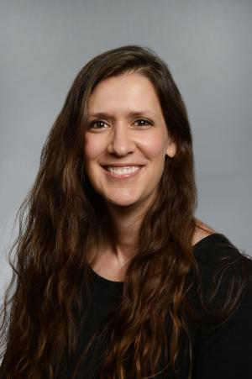
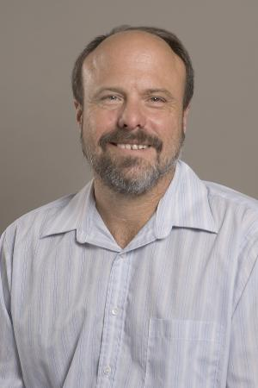
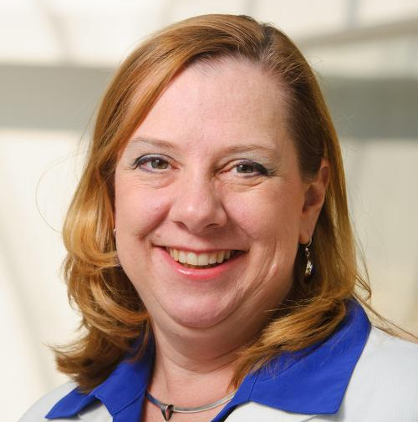
My sincerest gratitude to my defense committee!
Victoria Shaffer, Richelle Koopman, Ken Sheldon
Thank you for coming and listening to my defense!

Slide 41
Questions?

